Slide 1
tt.com

Slide 2
Why train tickets are always waiting?
- Every India Train Traveller
Railways Running on Losses a Sign of Gaps in ‘Overall Planning and Management’
- The Wire

Slide 3
So, What’s the PROBLEM?
Delhi
Mumbai
Bangalore
UP
Goa
Kerala
No Seat Available

Slide 4
How do we Solve this?
If a seat isn’t available for the whole journey, TT.com searches for seat availability for Partial Journey
Thus the traveller can book for Partial Journey on the reserved seat, & for the other part he/she can travel in
Available seat in the same class
Available seat in different class.
Unreserved Seat

Slide 5

How do we Solve this?
Delhi
Mumbai
Bangalore
UP
Goa
Kerala
Seat Available

Slide 6

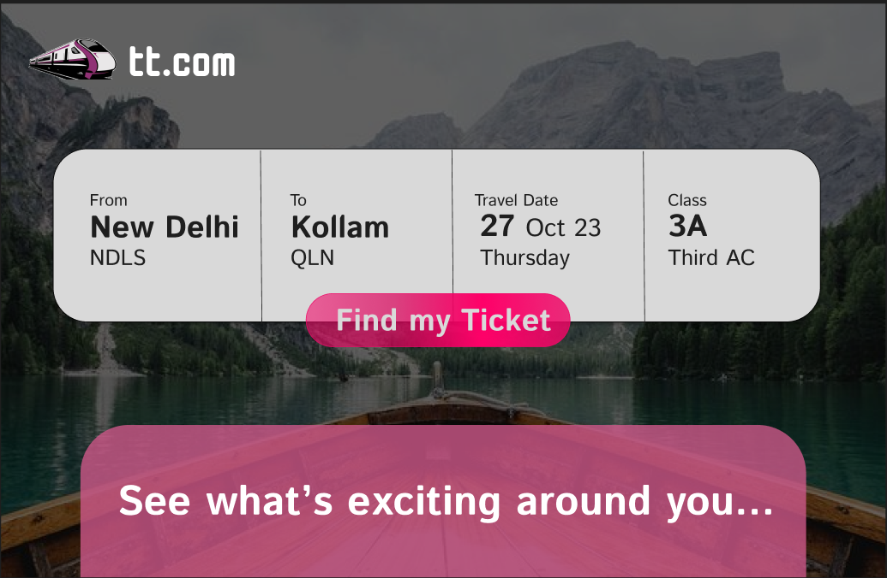

Slide 7
TT.com
Website
IRCTC
IRCTC
API
API
Seat Availability API

Slide 8
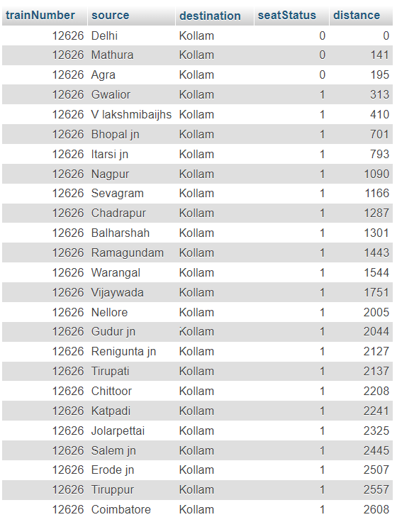

Slide 9
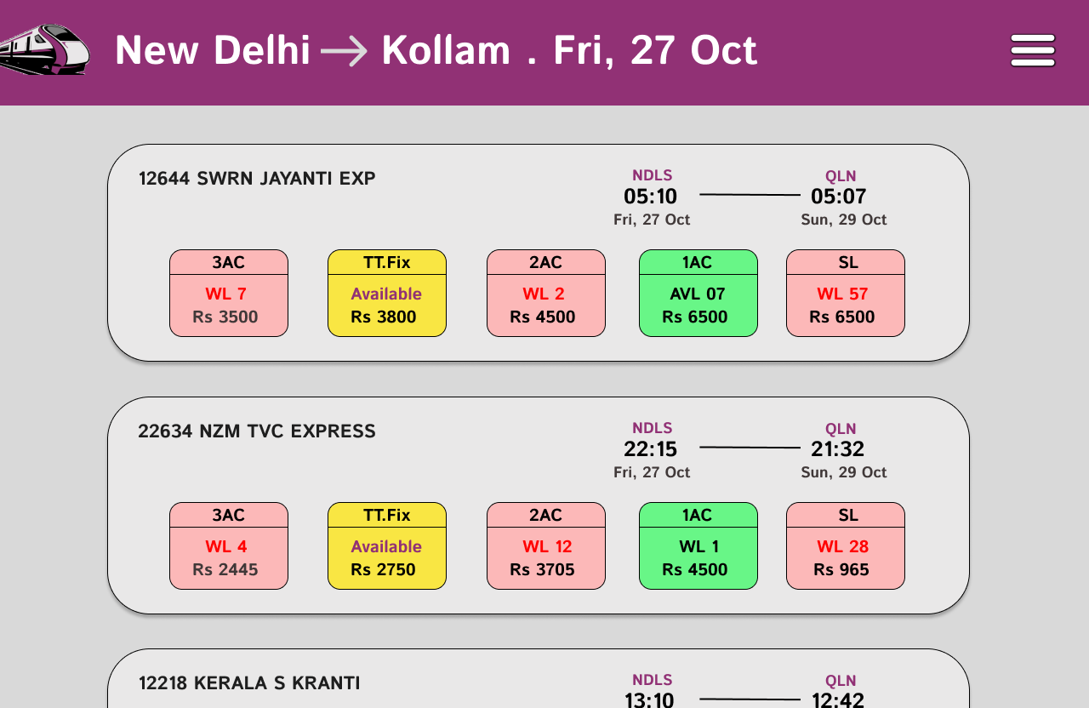

Slide 10
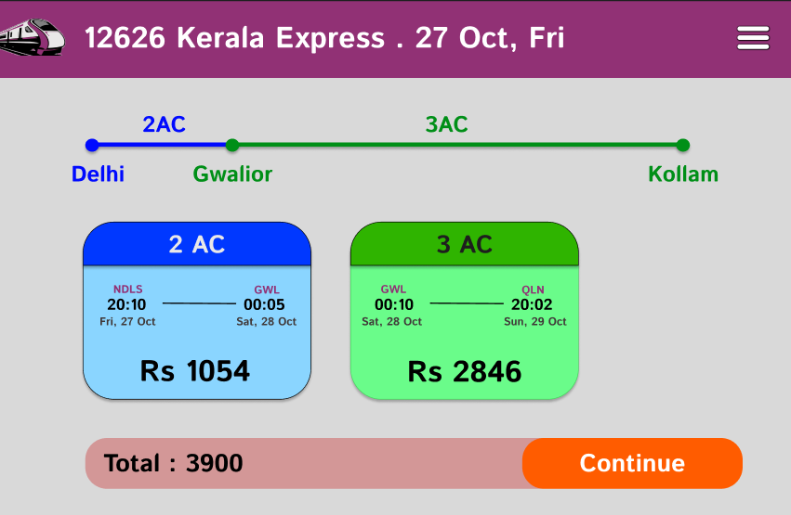

Slide 11
Vision & Future Goals
One Stop for Everything about Indian Trains.
Community of Travelers.
Ticket Booking
Integrate UTS (Unreserved Ticket Booking System).
Promise a Minimalistic Model.
Simple, Clean & Fast UI/UX.

Slide 12
Sustainability – Revenue Model
Competitive Pricing - Booking (Low Agent Charges) + Combine with Vouchers
UTS (Unreserved Ticket Booking System)
Advertising Opportunities.

Slide 13
Thank You

